Slide 1
Version Diagram

Slide 2
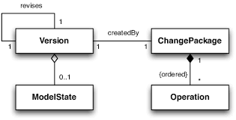
Definition
A version diagram is a visual representation that illustrates the evolution or progression of a product, system, or software over time. It typically displays different versions or iterations along one axis (usually vertical or horizontal) and a timeline along the other axis. Lines or arrows connect each version, indicating the sequence of releases and updates.

Slide 3
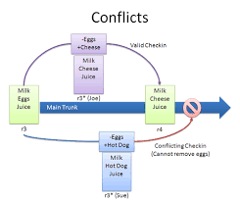
Description
Axis A version diagram typically consists of two axes. One axis represents versions or iterations, while the other axis represents time. Versions: Each version is depicted as a point along the version axis. Versions are usually identified by version numbers (e.g., V1, V2) or version names (e.g., Alpha, Beta, Release Candidate).Timeline: The timeline axis represents the passage of time. It is divided into increments such as months, quarters, or years, depending on the duration of the project or product lifecycle. Connections: Lines or arrows connect each version to its subsequent or preceding versions, indicating the progression of updates or releases over time. Annotations: Additional information, such as release dates, feature highlights, or milestones, may be included alongside each version to provide context and detail.

Slide 4
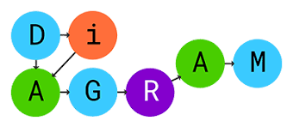
More Information
Purpose: Version diagrams are commonly used in project management, software development, and product planning to visualize the evolution of a project or product and track its progress over time. Types: Version diagrams can take various forms, including linear timelines, branching timelines (for parallel development branches), and network diagrams (for complex dependencies between versions).Tools: There are several software tools and platforms available for creating version diagrams, ranging from basic diagramming software like Microsoft Visio and Lucid chart to specialized project management tools like Jira and Trello.Collaboration: Version diagrams are often shared among project stakeholders, team members, and clients to communicate the project's development roadmap, gather feedback, and ensure alignment on project goals and timelines.

